Slide 1

Unlocking Hit Songs: Data-Driven Insights
Luis Martins
25/11/2025

Slide 2

01
Opening
02
Dataset
03
Methodology
CONTENTS
04
Results
05
Insights
06
Close

Slide 3

01
Opening

Slide 4

Why Hits Hide in Data
Spotify's Challenge
Data-Driven Strategy
Spotify hosts over 100 million tracks, but only 4% ever reach 1 million streams. In this vast ecosystem, artists struggle to stand out. Our research aims to decode the data behind hit songs, offering a strategic edge to navigate the algorithmic noise and achieve success.
Our study leverages data analytics to identify the key differences between high and low popularity songs on Spotify. By translating these insights into actionable production rules, we aim to turn intuition into evidence-based strategies for artists and producers.

Slide 5

Research Goal & Questions
01
02
03
Objective
Research Questions
Actionable Insights
The primary objective of our research is to identify the differences in audio and metadata features between high and low popularity songs on Spotify. We aim to provide strategic advice to artists and producers to enhance their chances of creating hit songs.
Our study is guided by four key questions: Which audio features predict a song's popularity? How do structural elements like tempo and duration influence success? Does the release year impact popularity? Can machine learning accurately forecast hit songs?
By answering these questions, we aim to provide actionable insights that can be directly applied during the production and release of music, helping artists make data-driven decisions to increase their chances of success.

Slide 6
02
Dataset

Slide 7

Data Scope & Ethics
Data Source and Ethics
Our dataset comprises two Kaggle CSV files merged into Total records: 4829 and Total features: 25. We ensured ethical use by avoiding personally identifiable information and acknowledging the static nature of the dataset, which limits our analysis to predefined popularity labels.

Slide 8

Key Descriptive Insights
Tempo and Duration
Time Signature
Energy and Loudness
Our analysis reveals that popular songs cluster around 120-130 BPM and have a duration of 3 minutes 20 seconds to 4 minutes 10 seconds. These findings suggest an optimal range for song structure that aligns with listener preferences.
Songs in 4/4 time signature dominate the popular category. This common rhythm is associated with higher danceability and popularity, indicating that a strong, familiar beat is a key driver of success.
High energy and loudness are significant predictors of popularity. These features reflect modern production standards and listener preferences, suggesting that mastering for perceived volume and energy is crucial for hit songs.
Release Year
The data shows that songs released between 1954 and 2024 dominate popularity rankings. This highlights the importance of aligning with contemporary sonic standards and evolving listener tastes.

Slide 9
03
Methodology

Slide 10

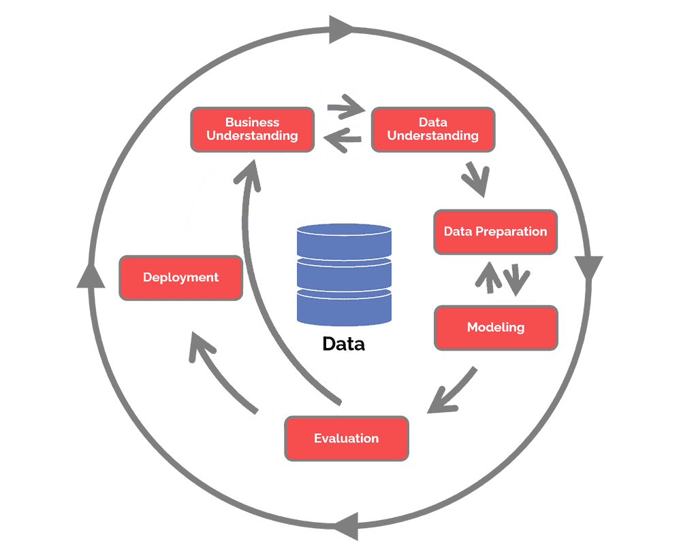

Slide 11

CRISP-DM Pipeline
Business Understanding
Data Preparation
Modeling
We framed the problem of music discovery as a binary classification and regression challenge, aiming to identify which songs would achieve high popularity. This approach aligns with the strategic goal of helping artists break through the noise.
Our data preparation involved merging files, engineering features like release year, month, and day, normalizing audio features, and one-hot encoding categorical variables. This ensured a robust dataset for modeling.
We compared three machine learning algorithms: Random Forest, SVC, and XGBoost with grid-searched hyperparameters and 3-fold cross-validation. This rigorous approach ensured we identified the best-performing model.

Slide 12

Model Lineup & Metrics
Regression Models
Classification Models
We also explored regression models to predict exact popularity scores using R² and RMSE. This allowed us to test the granularity of our predictions and determine the best approach for forecasting hit songs.
We trained Random Forest, SVC, and XGBoost classifiers to predict binary popularity. We measured performance using accuracy, precision, recall, and F1-score, aiming to identify the most reliable model for strategic recommendations.

Slide 13
04
Results

Slide 14


Winning Classifier
Random Forest Performance
The Random Forest classifier achieved the highest test accuracy at 89.75% and cross-validation score at 87.89%. Its robustness to multicollinearity and clear feature importance rankings made it the best choice for strategic insights.

Slide 15
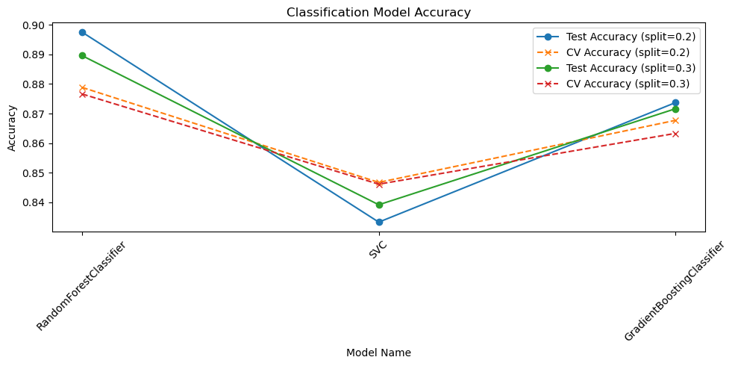

Slide 16


Regression Reality Check
Low R² Scores
Strategic Implications
The XGBoost regressor achieved an R² score of only 0.1866, indicating that audio features alone are insufficient to predict exact popularity scores. This confirms that classification is more reliable for strategic decisions.
The low explanatory power of regression models highlights the limitations of predicting precise popularity scores. Instead, classification offers a clearer path for artists to make data-driven decisions.

Slide 17
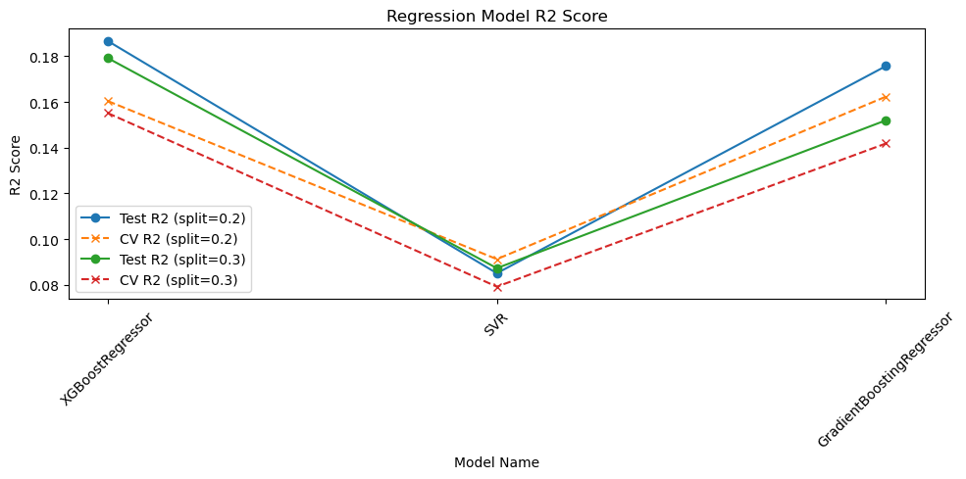
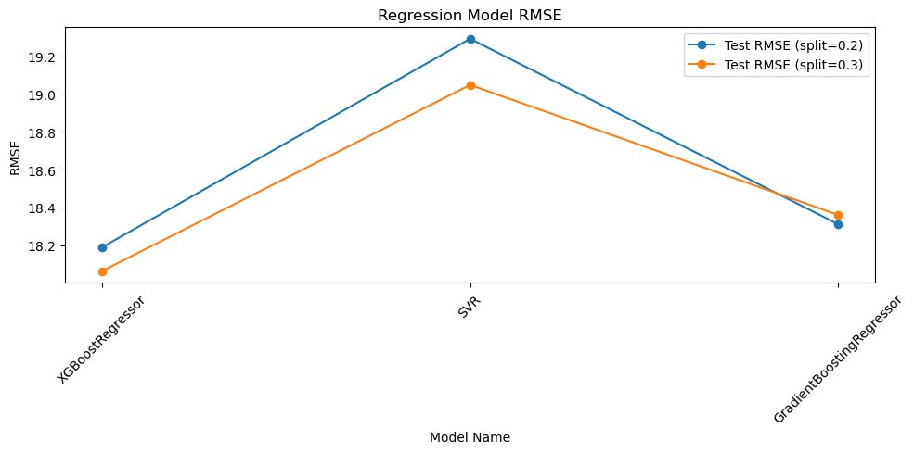

Slide 18
05
Insights

Slide 19



Top Predictive Features
Loudness and Energy
Loudness and energy were key drivers of popularity. These features reflect perceived volume and intensity, suggesting that investing in high-quality mastering is crucial for creating hit songs.
Release Year
Release year emerged as a top predictor, emphasizing the importance of aligning with contemporary production standards. Artists must ensure their music reflects modern sonic trends to resonate with listeners.
Danceability
Danceability consistently ranked high, indicating that songs with strong, clear beats have a higher probability of success. Producers should focus on creating engaging rhythmic elements to enhance popularity.

Slide 20


Strategic Recommendations
Modern Production
Energy and Groove
Artists should prioritize modern production styles to align with contemporary listener preferences. Ensuring that their music reflects current sonic trends is essential for achieving high popularity.
Investing in loud, energetic masters and crafting danceable grooves are strategic priorities. These elements significantly influence a song's popularity, offering a clear path for artists to enhance their chances of success.

Slide 21
06
Close

Slide 22




Challenges & Next Steps
Static Dataset
Correlation vs. Causation
The static nature of our dataset limits our analysis to predefined popularity labels. Future work will migrate to the Spotify API for real-time data, ensuring more accurate and dynamic insights.
While our models identify correlations, they do not establish causation. Future research will focus on deeper explainability tools like SHAP to uncover the underlying reasons behind a song's popularity.
Missing Variables
Future Work
Our dataset lacks crucial external variables like marketing budgets and playlist placements. Integrating these factors will provide a more comprehensive understanding of what drives a song's success.
Future steps include migrating to the Spotify API, integrating social media signals, and applying SHAP for instance-level explanations. These enhancements will provide more robust and actionable insights for artists.

Slide 23

Takeaway for Artists
Data-Driven Success
Our research shows that hits are not mystical but exhibit measurable traits like loudness, energy, and danceability. By focusing on these evidence-based levers, artists can boost their discoverability and increase their chances of creating hit songs.

Slide 24
THANK
YOU
Luis Martins
25/11/2025

